Slide 1


Pay It Forward
André Hoffmann Pr. Tech. Eng. MBA FSAIEE MIEEE
26 March 2015

Slide 2
Building on the shoulders of many who have gone before me
2016 >> ?
André Hoffmann
2015: Pay It Forward to have a sustainable future
Dr Pat Naidoo
2014: Membership and customer focus towards a world class South Africa
Paul van Niekerk
2013: Skills development and professionalism towards infrastructure development
Mike Cary
2012: Energy Efficiency and Renewables
1909 … 2011

Slide 3


Slide 4
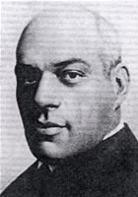

Bernard Price
SAIEE President in 1915
Mr. Price concluded the first part of his inaugural address…
‘The Institute could perhaps do something more than is at present being done in the direction of advising and assisting youthful engineers on matters pertaining to their advancement.’
[Source The First Ten Decades P17]

Slide 5
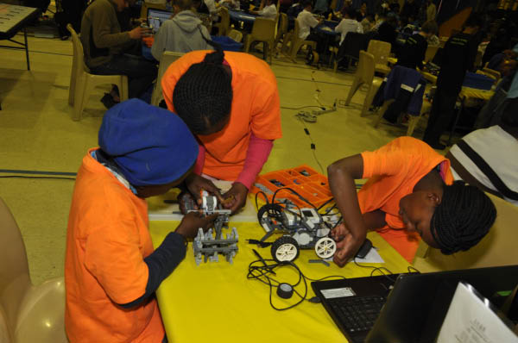
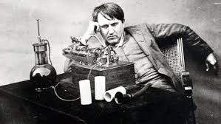
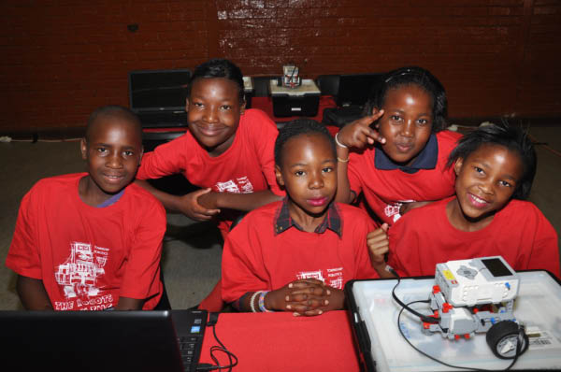
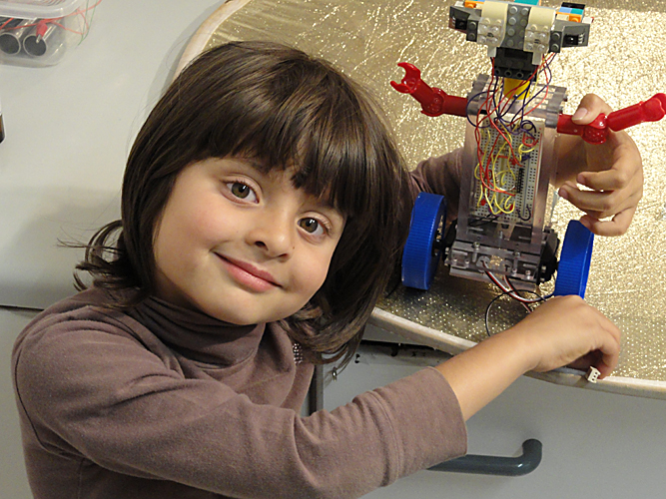
Edison

Slide 6

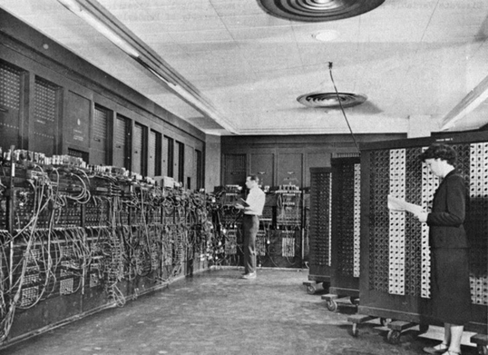
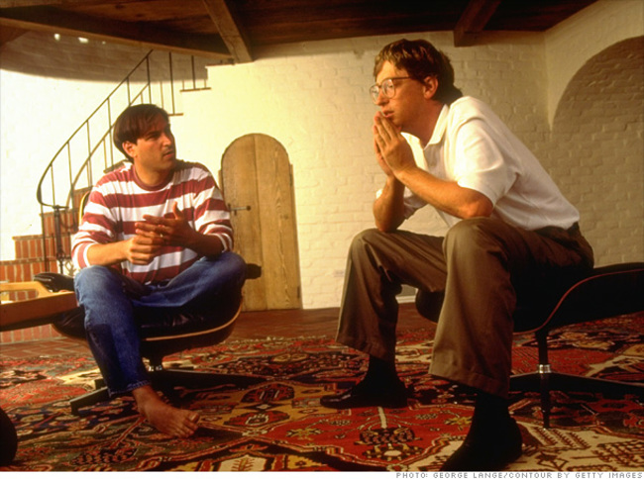
The Future isn’t what it used to be
News report from 1981
Steve Jobs sitting with Bill Gates discussing the future of computing in 1991
The US-built ENIAC (Electronic Numerical Integrator and Computer) was one of the first computer ever made

Slide 7
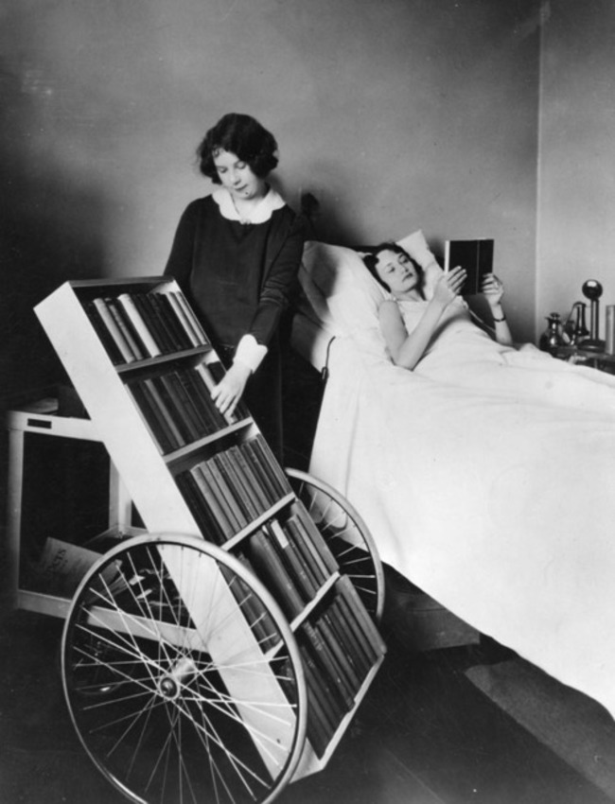
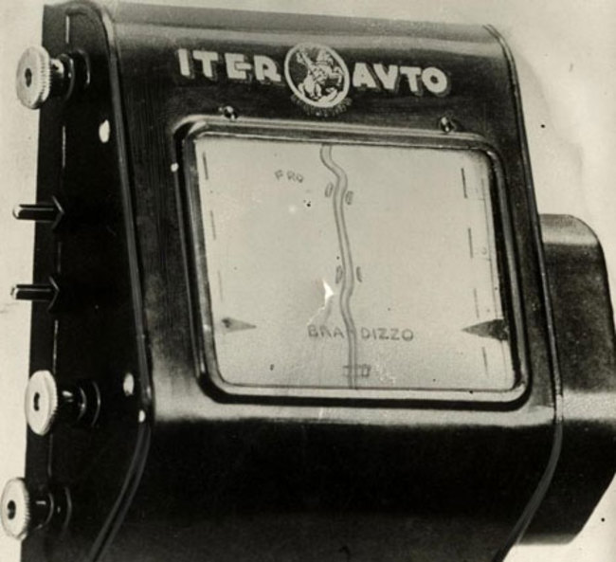
Kindle equivalent in 1928 / a GPS in 1930

Slide 8
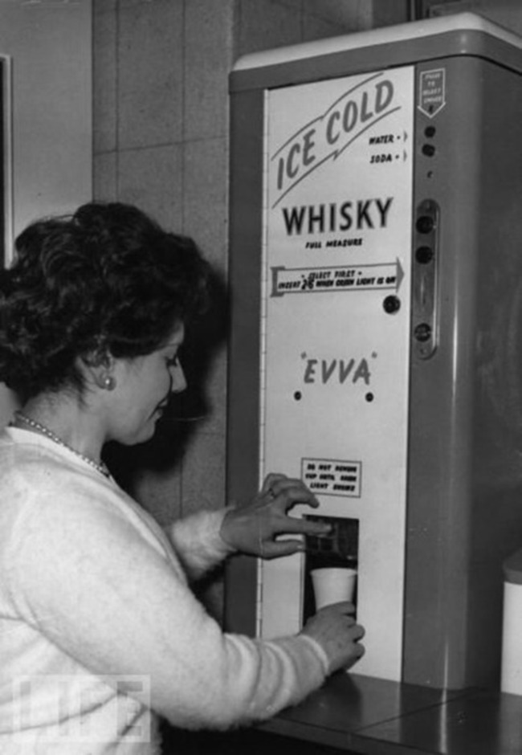
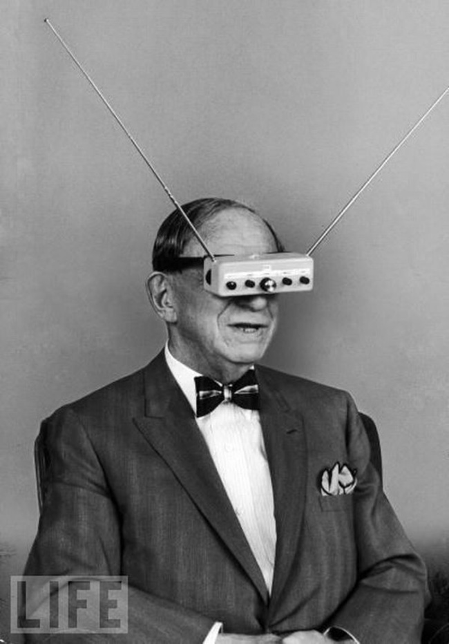
Found in discerning offices in the 1950’s – a whisky dispenser
TV Glasses? In 1963

Slide 9
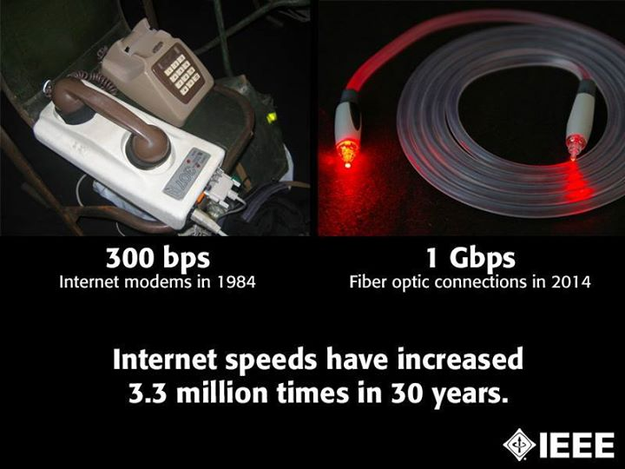
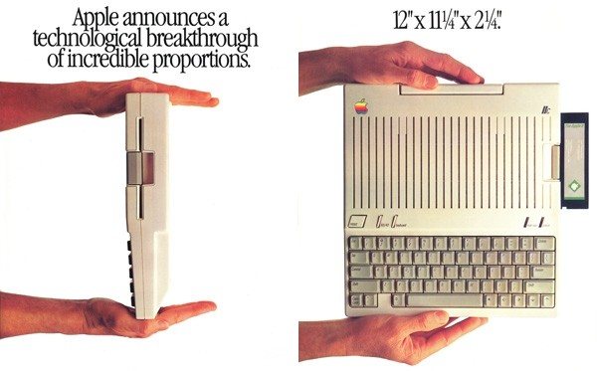
Increased internet speeds

Slide 10

The 1989 Science Fiction movie…
"Getting BACK was only the beginning..."

Slide 11
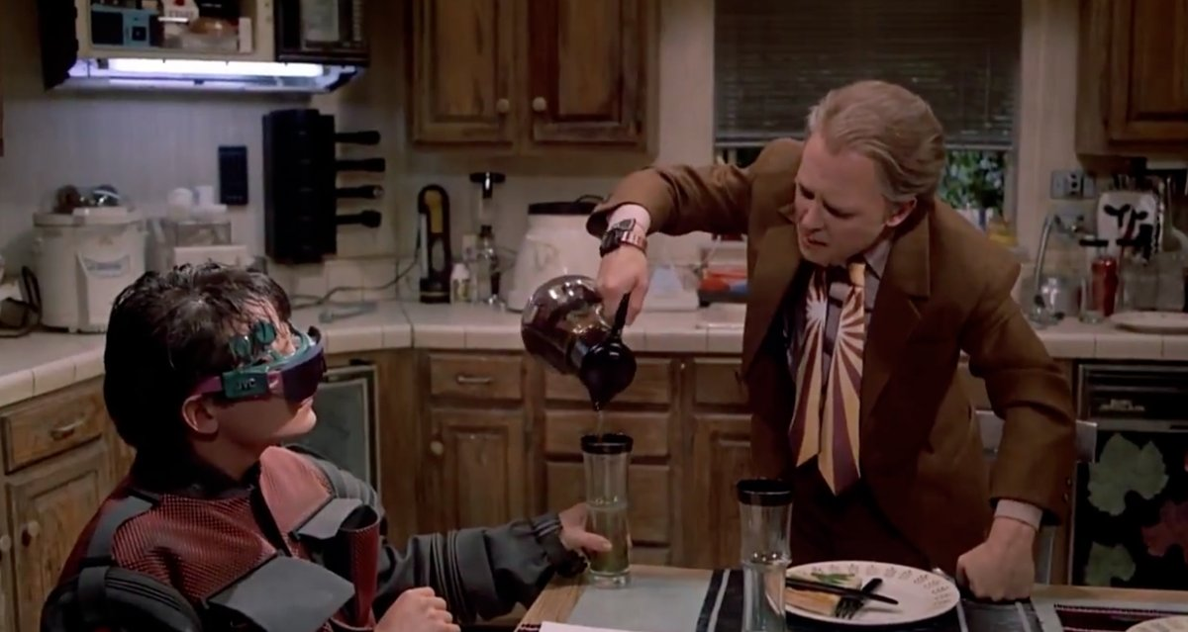
Wearable technology

Slide 12
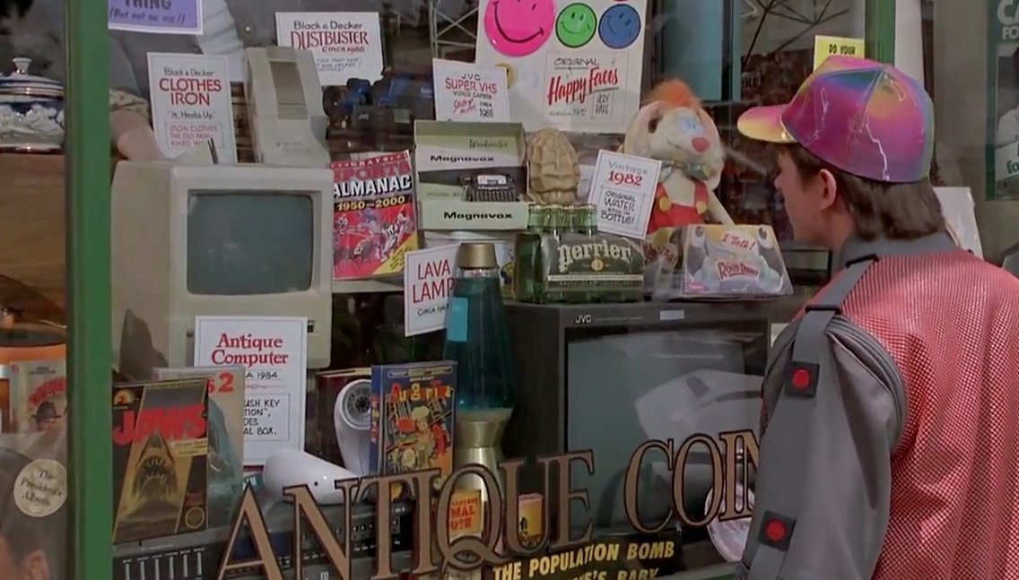
Some things would be obsolete

Slide 13
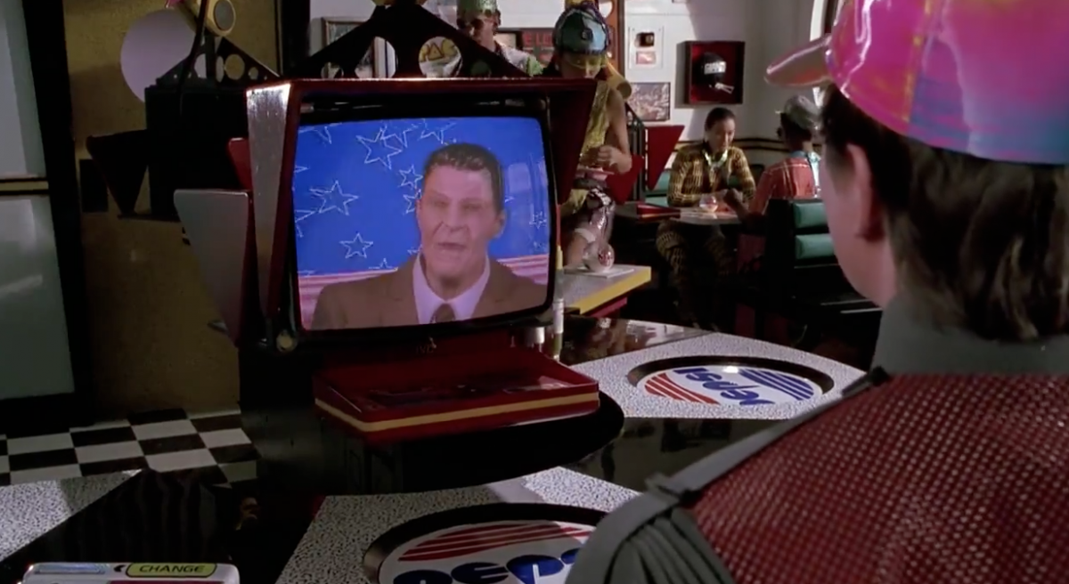
Voice controlled ordering systems

Slide 14
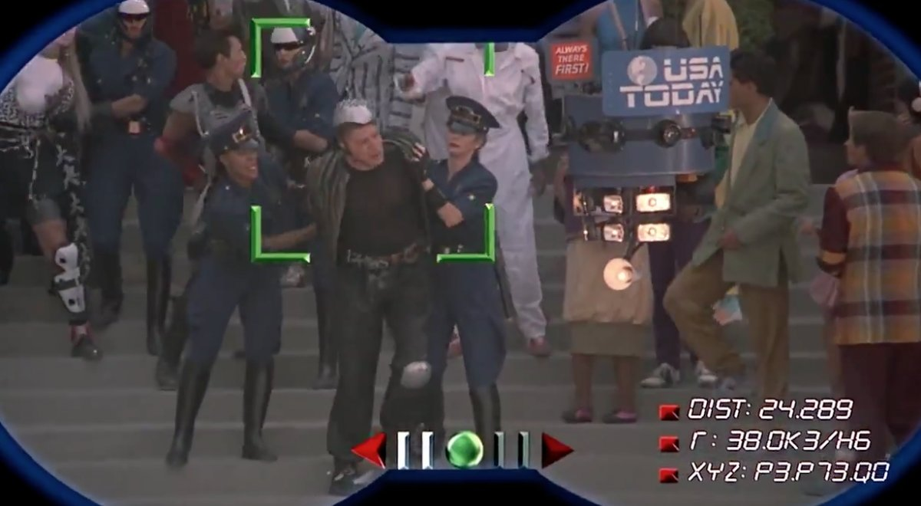
News footage filmed by a drone

Slide 15
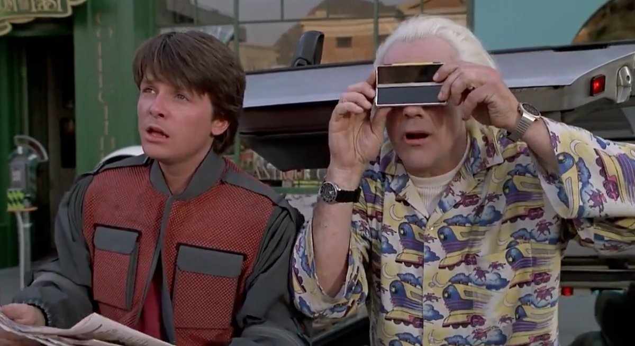
Digital Cameras

Slide 16
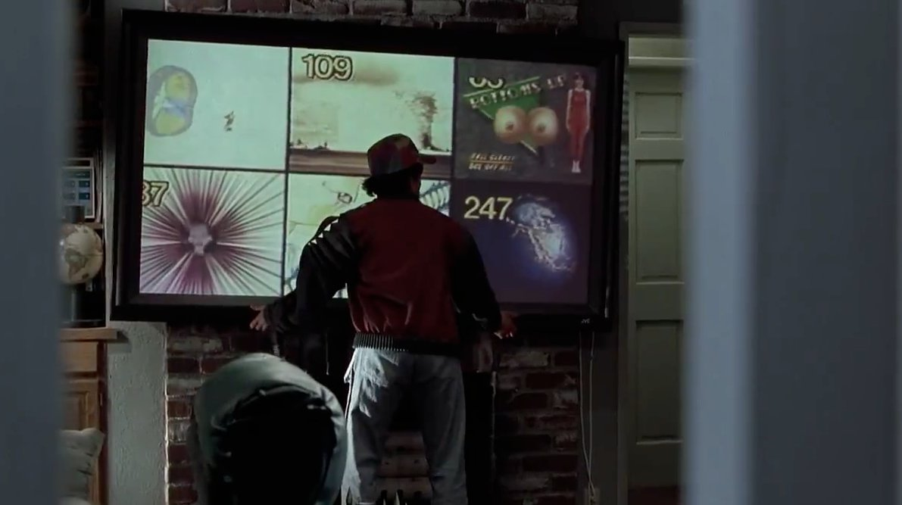
Multiple video channel displays

Slide 17
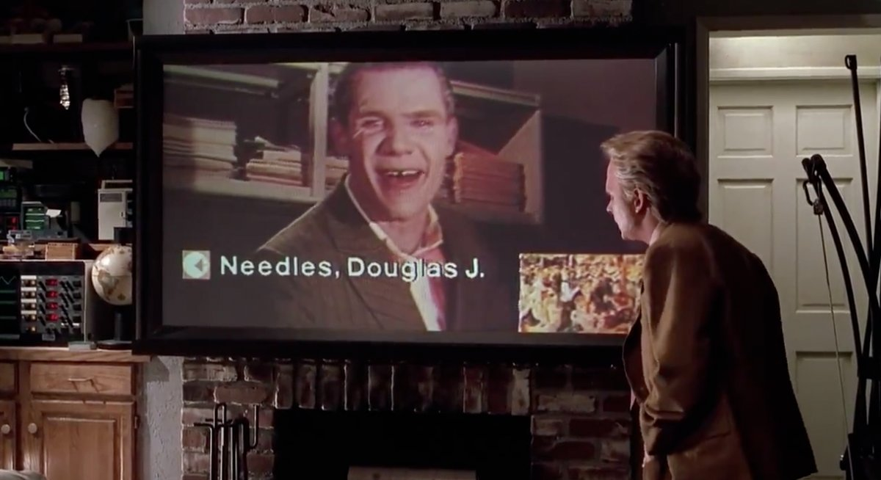
Video Conferencing and wall mounted wide-screen TV

Slide 18
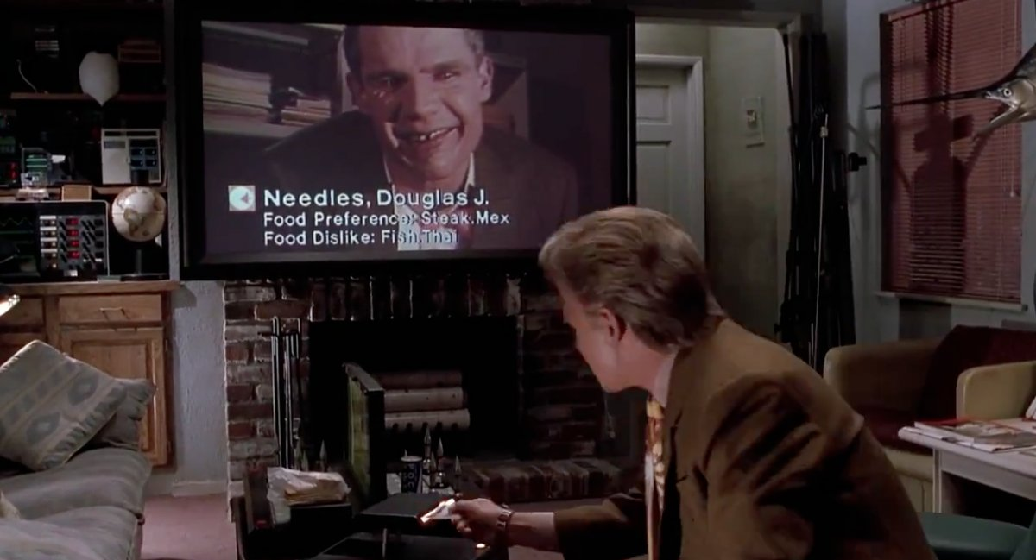
Mobile credit card reader

Slide 19
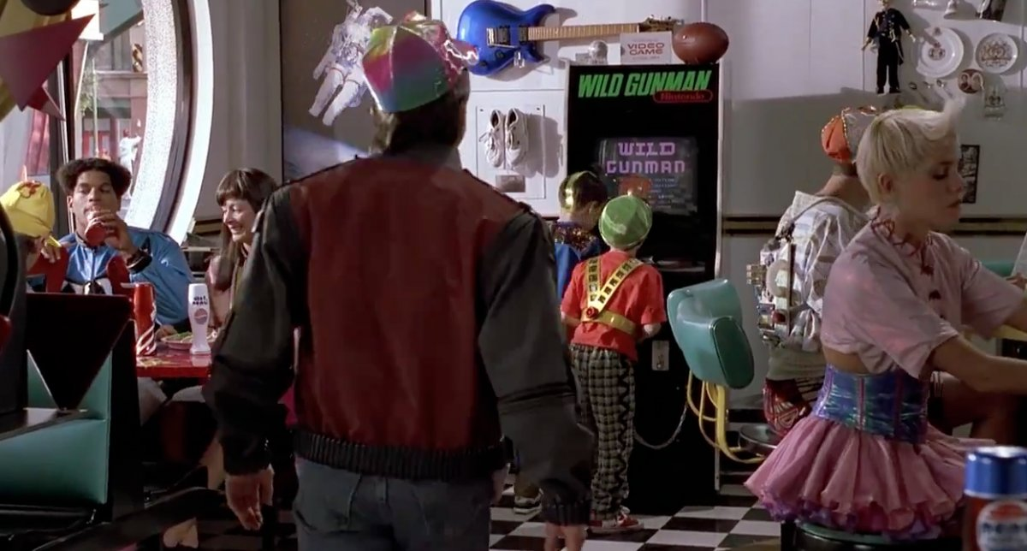
Hands free gaming devices
Wii
xbox

Slide 20
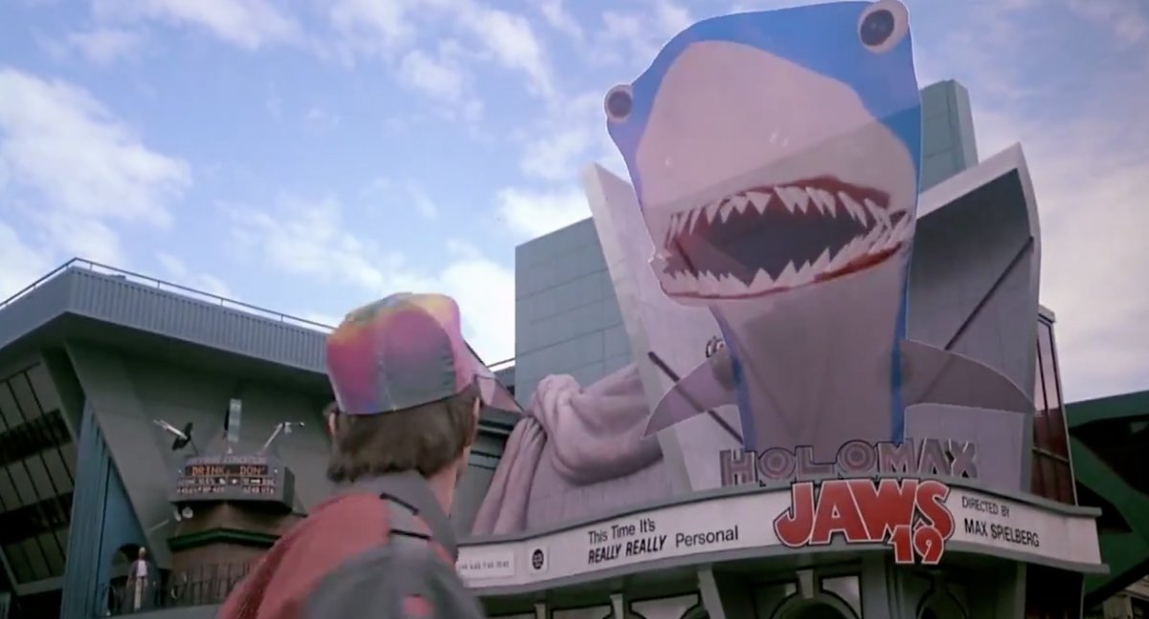
3D blockbuster films

Slide 21
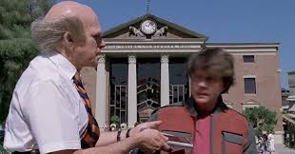
Handheld tablet computers

Slide 22
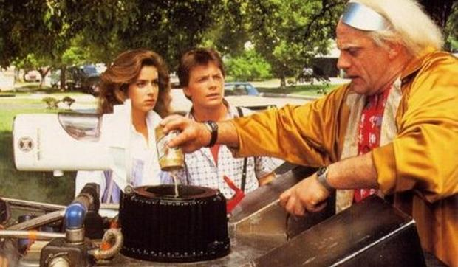
Waste to Fuel

Slide 23
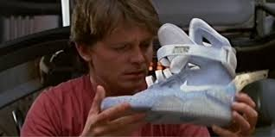
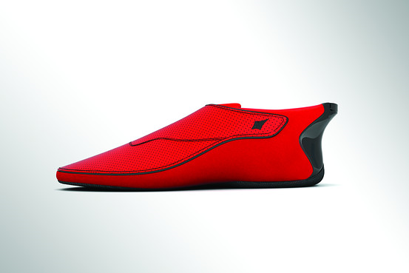
Auto Lacing Sneakers?
India’s Answer to Google Glass: The Smart-shoe

Slide 24
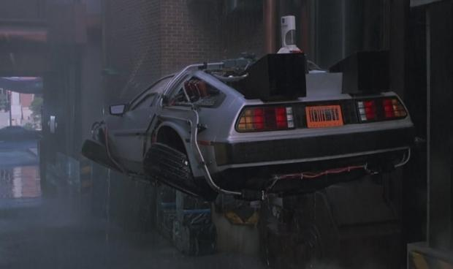
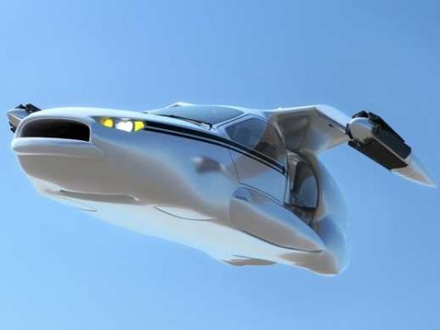
Flying Cars?
A concept flying car
Terrafugia has put forward their vision for a practical flying car. Using electric-gasoline hybrid technology, the company thinks they have what's needed to bring a flying car to the mass market
http://www.terrafugia.com/

Slide 25
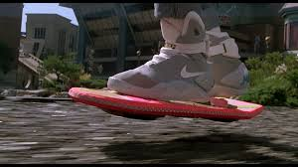
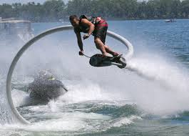
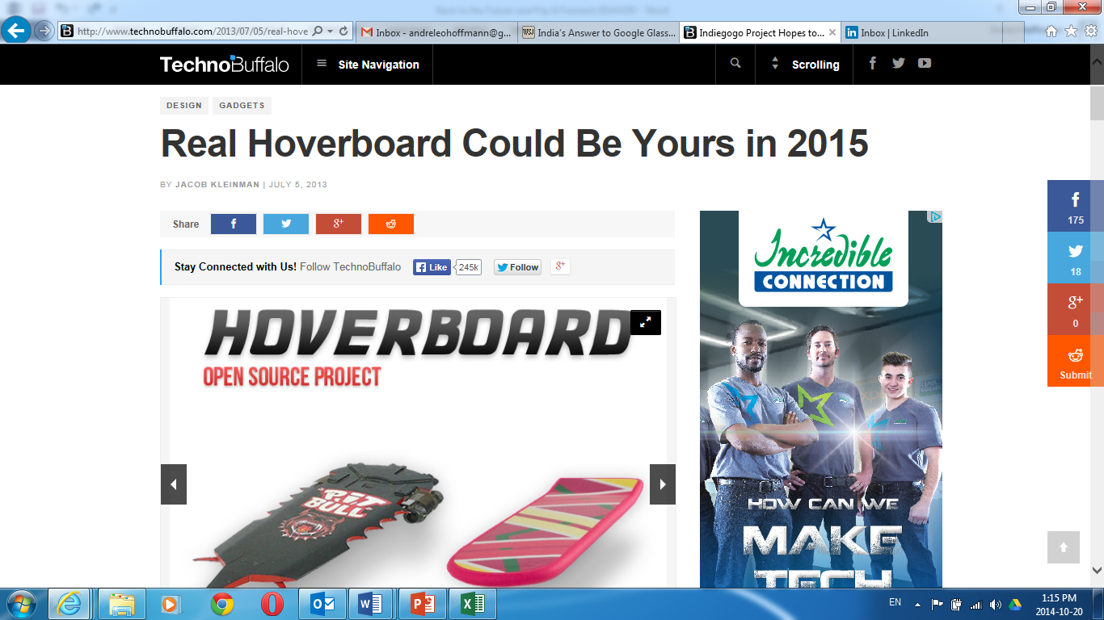
Hover boards?

Slide 26
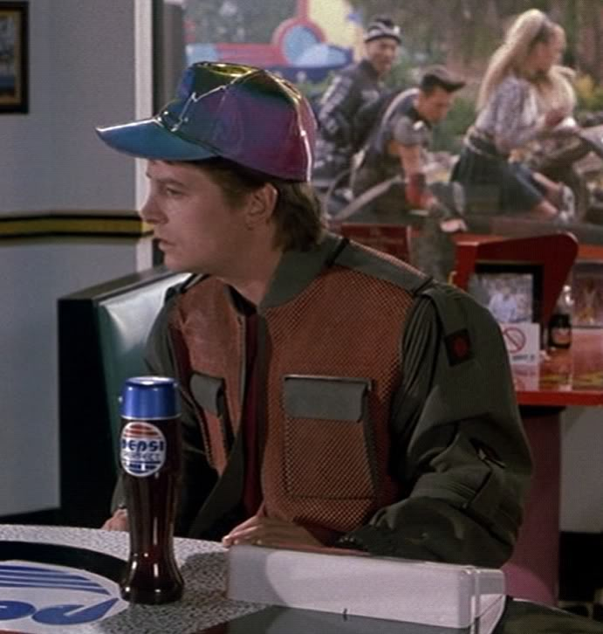
Pepsi – what were you thinking?

Slide 27

Some predictions for 2025
solar is the largest source of energy on the planet. Methods for harvesting, storing and converting solar energy are so advanced and efficient that it becomes the primary source of energy on our planet.
electric air transportation takes off. Lightweight aerospace engineering coupled with new battery technologies power electric vehicle transportation - on land and in the air.
digital everything everywhere. From the smallest personal items to the largest continents, everything, everywhere will be digitally connected, and responsive to our wants and likes.
teleportation is tested (Beam me up Scotty :-). Kinematical techniques used to understand the Higgs Boson particles generated in the Large Hadron Collider advance such that quantum teleportation is more commonplace.
Now, the arrogance of success is to think that what you did yesterday will be sufficient for tomorrow. [William Pollard]

Slide 28
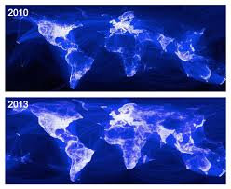
World Map of Facebook users
Source:
Arthur Goldstuck

Slide 29
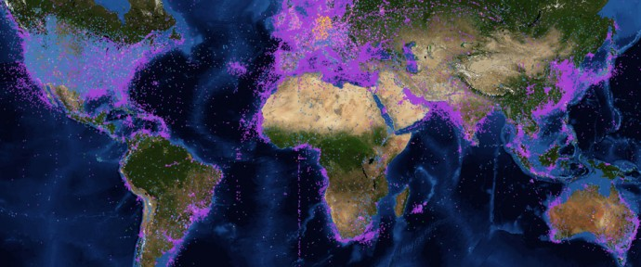
World Map of Internet of Things
Source: Arthur Goldstuck
This map shows all the connected devices that have embedded chips that allow them to communicate with other machines. It includes smart meters, radiation sensors, seismographs, ships, aircraft, and even animal trackers.

Slide 30
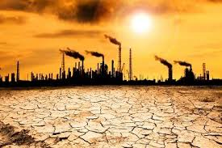

Lets build a future we actually want to live in
Elon Musk, the billionaire chief executive of SpaceX and Tesla Motors may be a techno-optimist when it comes to solar power, space exploration and electric cars, but he continues to express his concerns that super-intelligent machines might one day pose a threat to human existence.

Slide 31
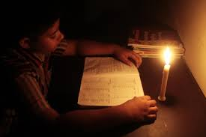


Slide 32
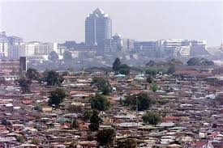
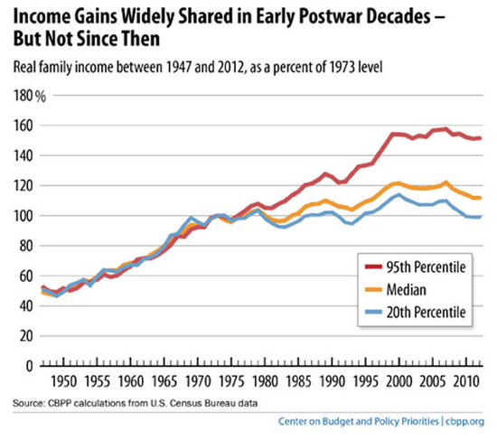
Mind the Gap…

Slide 33

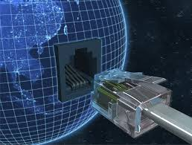
Two possible ways forward…
Education…Education…Education
Ubiquitous low cost Broadband

Slide 34
The Institute could perhaps do something more than is at present being done in the direction of stimulating an interest in engineering within the youth.

Slide 35

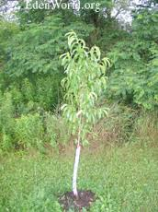
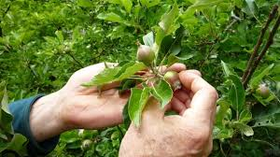
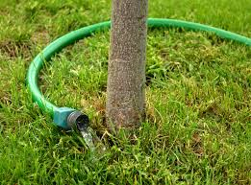
The formula is a simple one…
Engineers & Technologists
Technicians
Good students
with
Maths & Science
Grade10
Maths and Science
The inquisitive

Slide 36
Some Examples

Slide 37
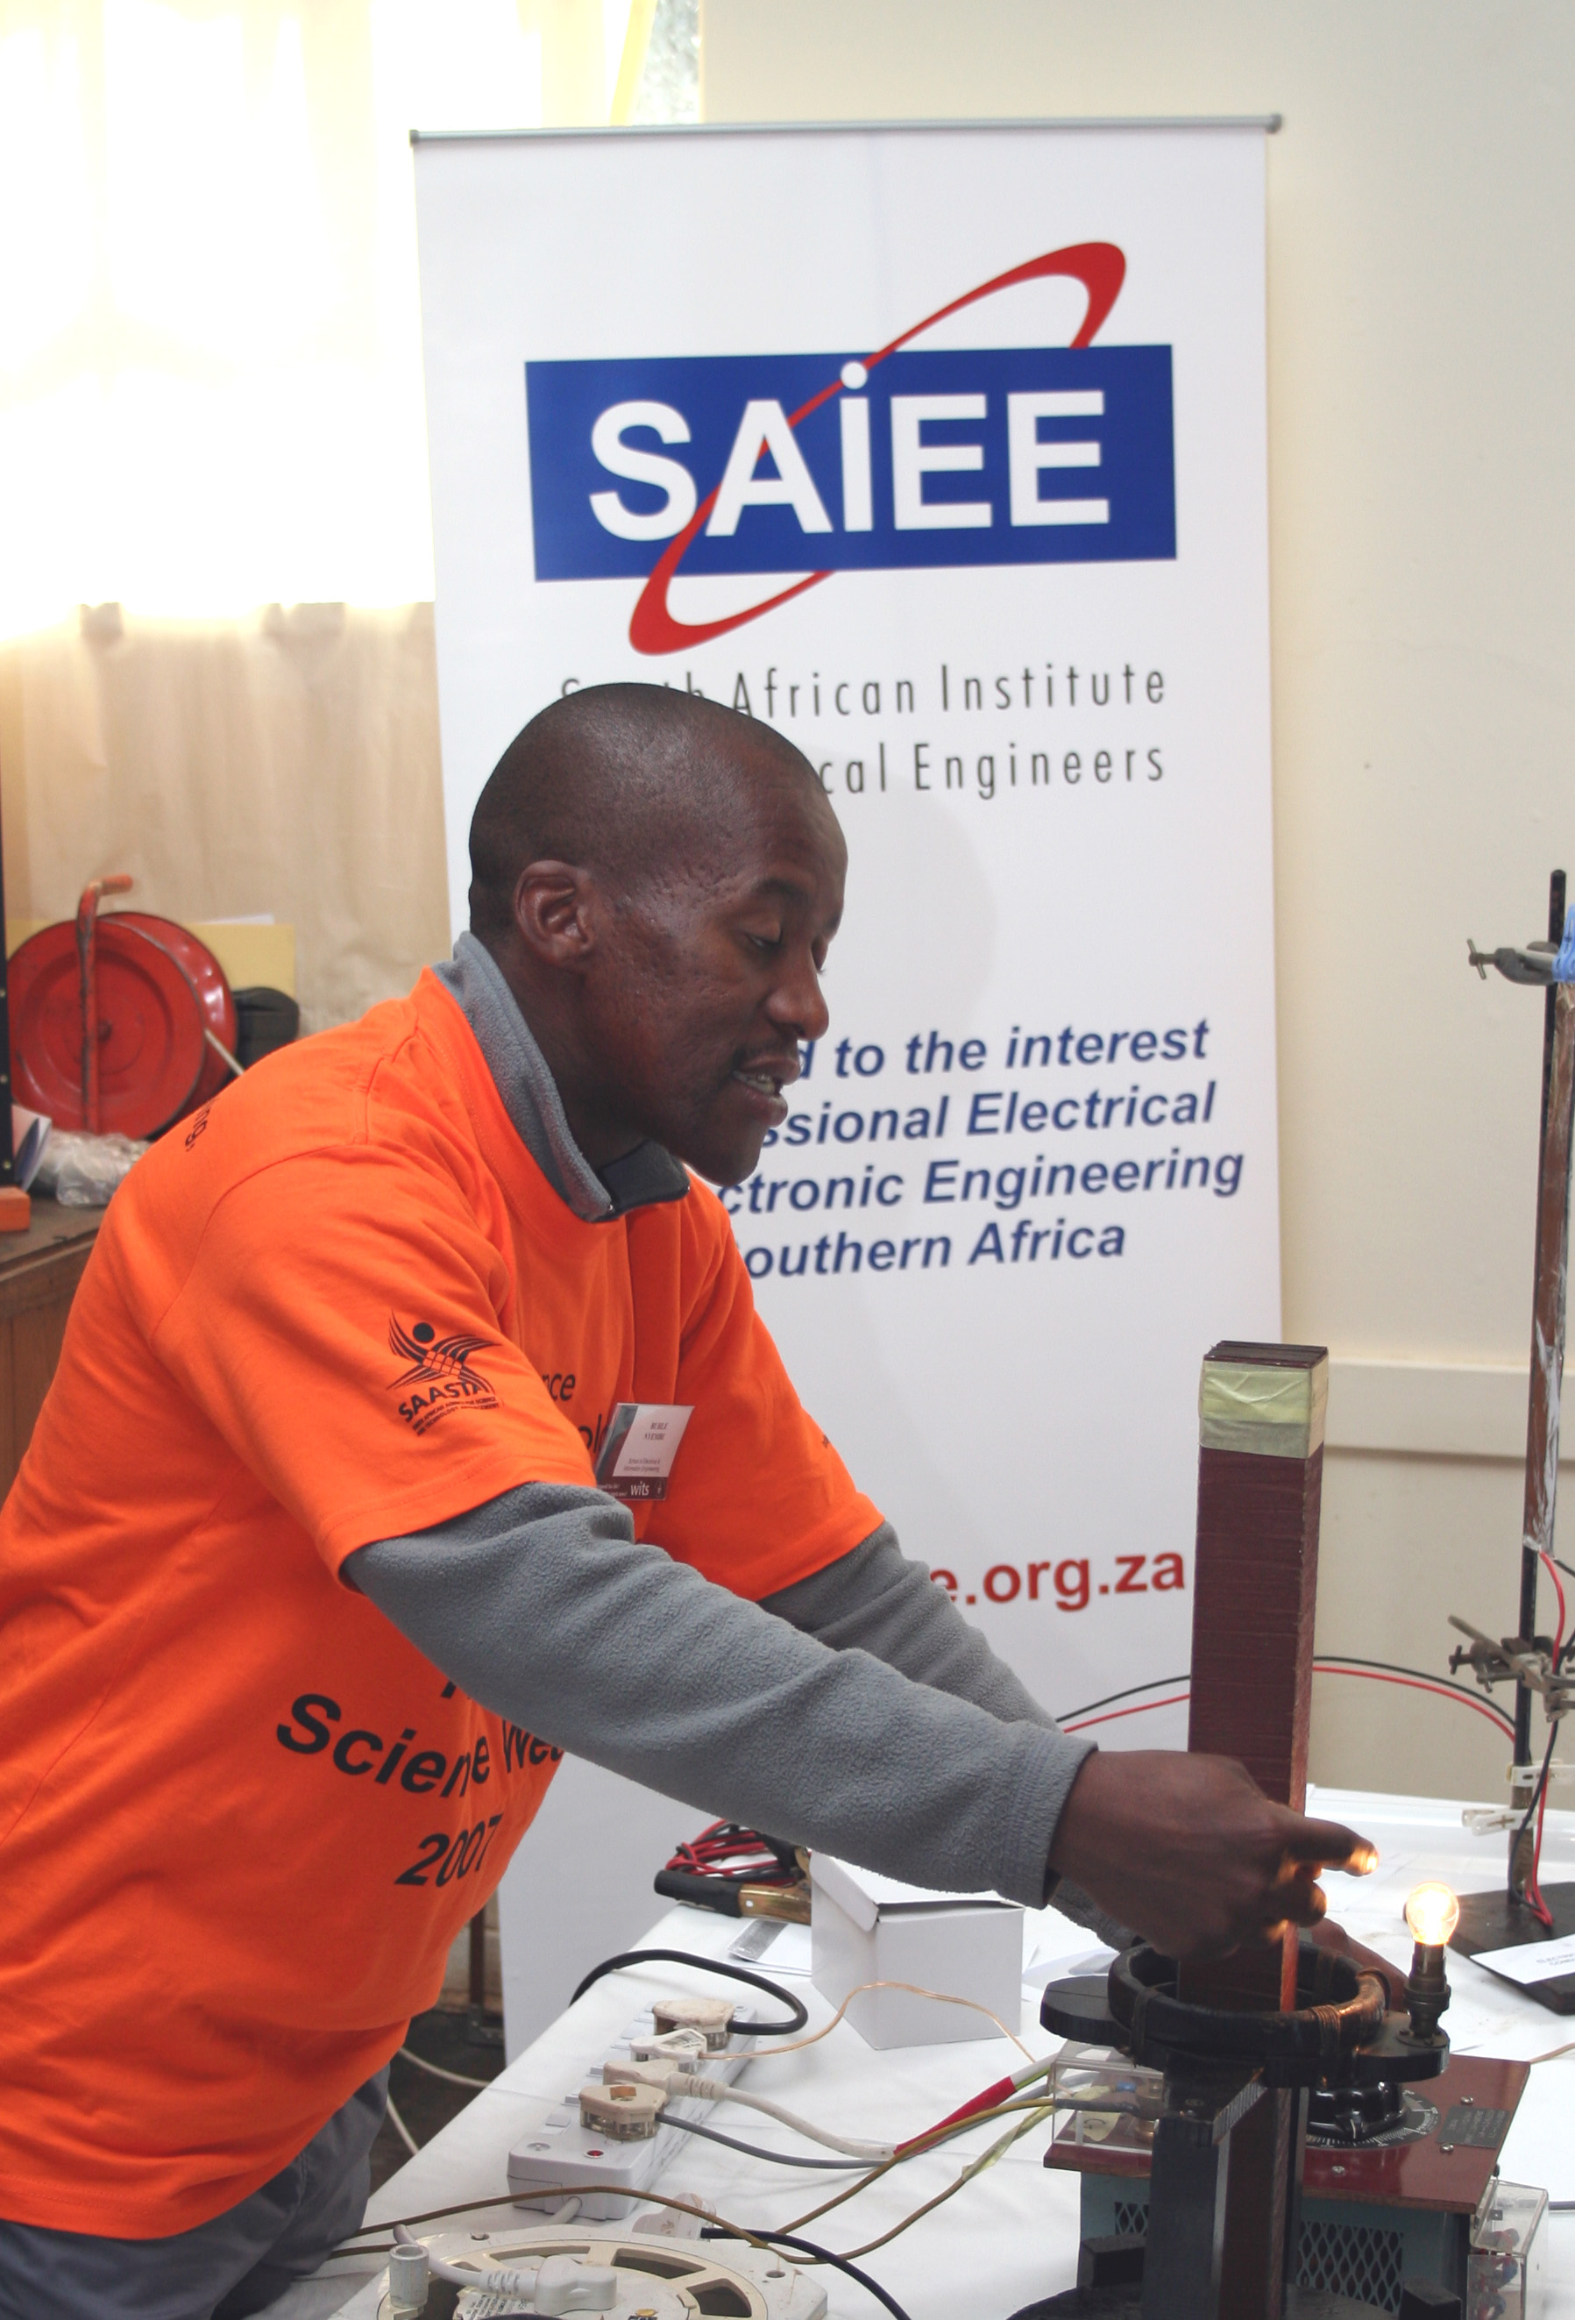
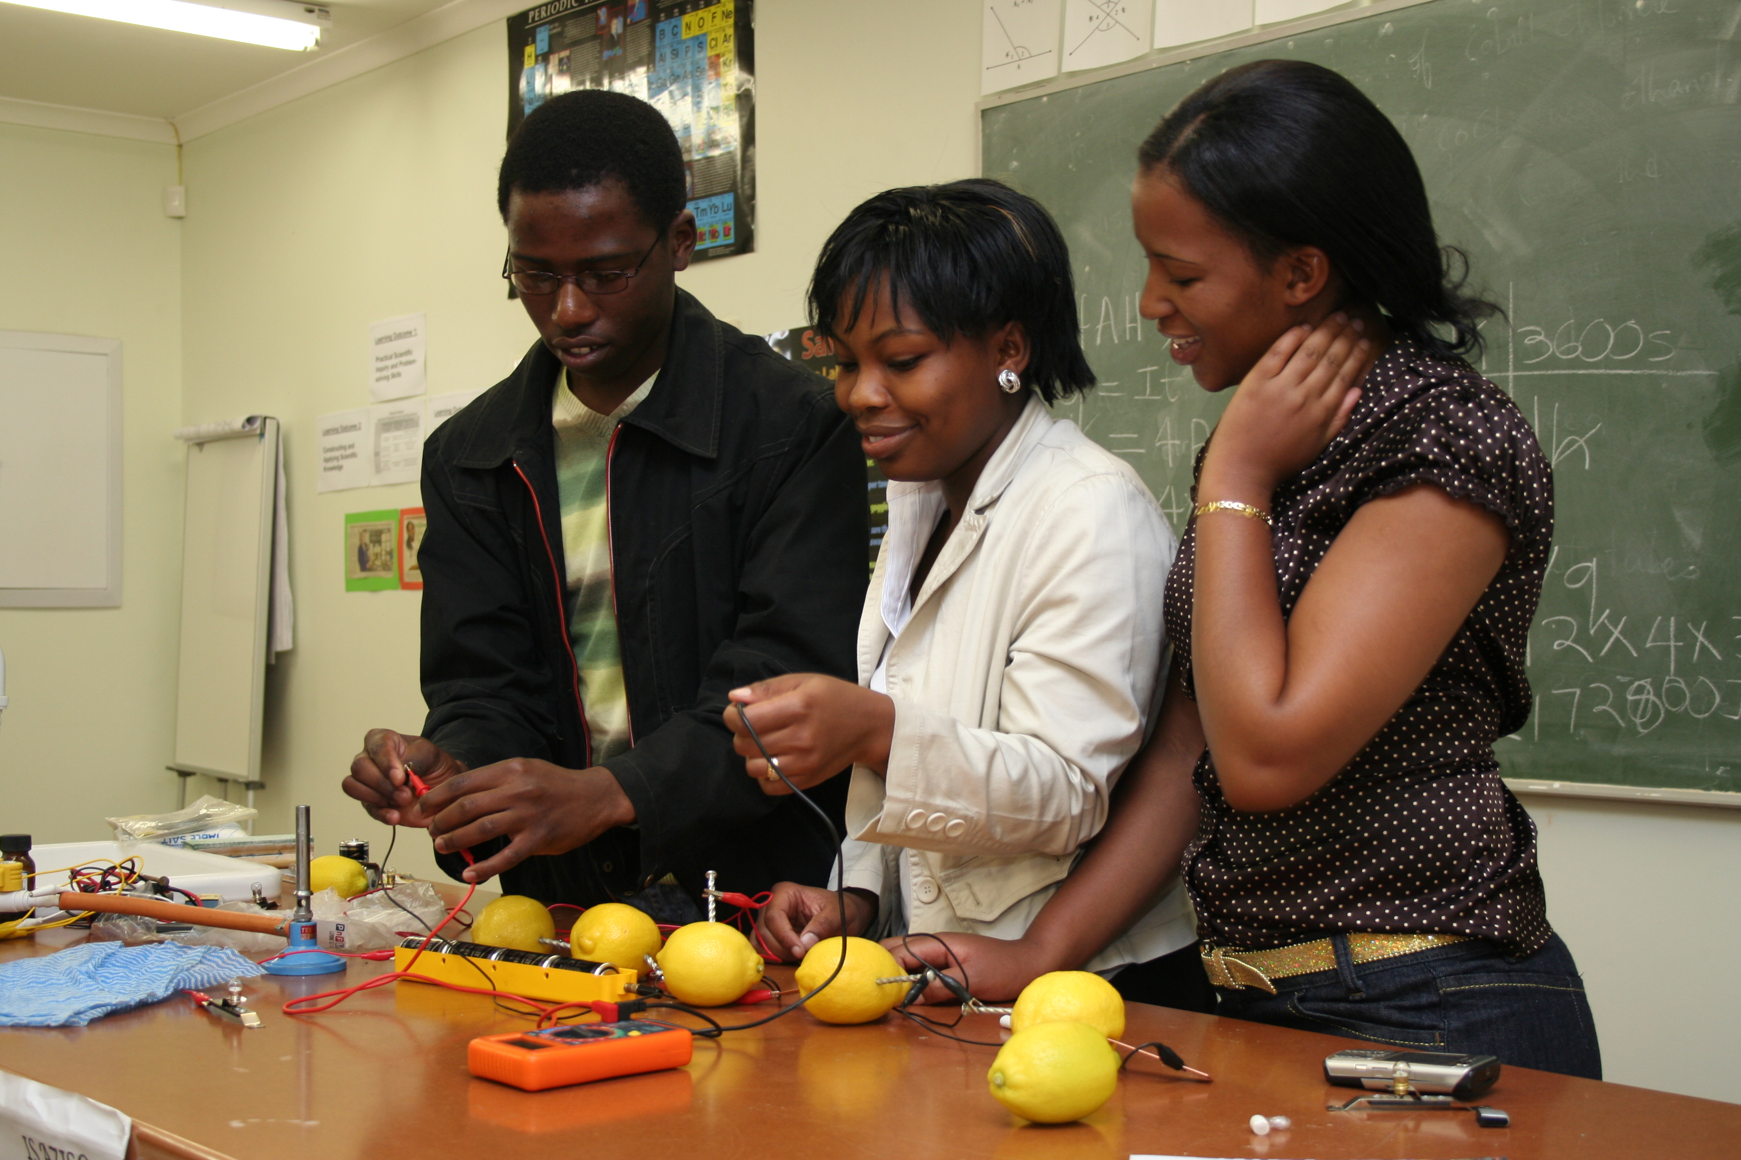
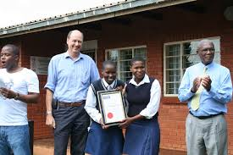


The Bergville Schools Project
Tutoring sessions
National Science Week
Career Day
Grade 10 and up

Slide 38
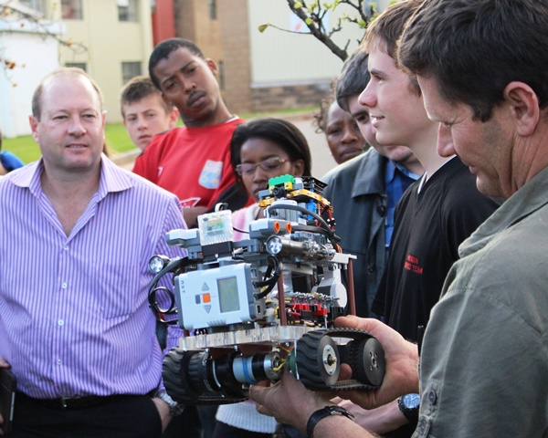
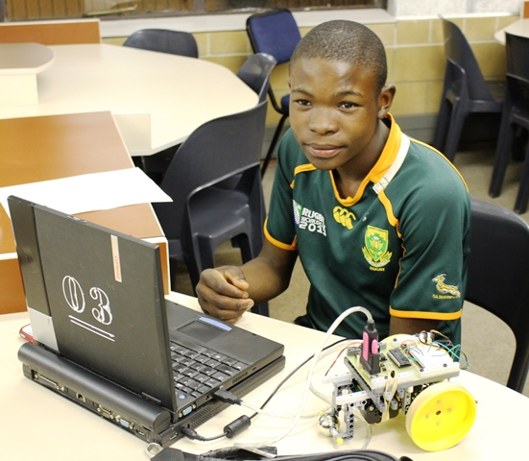
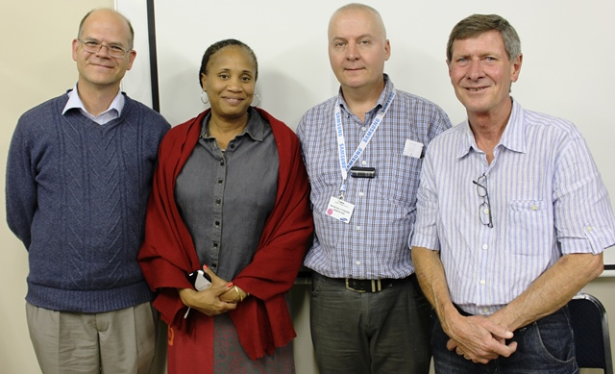
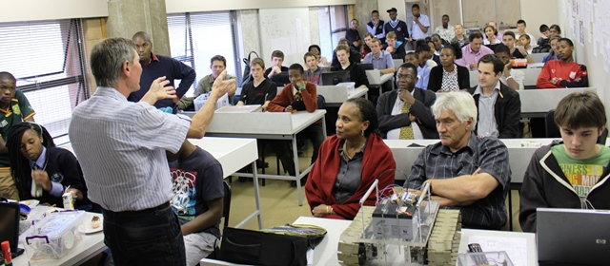
Ages 14 and older
(Grade 9)
See: http://www.robotscience.co.za/UJ/

Slide 39



Don’t underestimate the talent around us…
Grade R to Grade 7
From an indigent South African Township to the World Robot Olympiad in Malaysia
Finishing second in the WRO competition in South Africa, the ‘Crazy Divas’ went to the international WRO event in Malaysia in November 2012. (Sponsored by the LEGO Foundation.) see: http://www.handsontech.co.za/

Slide 40
Remember the formula…
The Engineer / Technologist
The Student
Grade10
The inquisitive

Slide 41

‘The efficiency of the industrial and commercial machine must ultimately depend to a large extent on the skill of those who control it.’ Bernard Price
Active membership
Corporate Partnership

Slide 42
References
News report from 1981: https://www.facebook.com/photo.php?v=615203105216064
Surprising photos from the past: http://news.distractify.com/people/scenes-from-the-past-you-never-expected-never-seen-before/?v=1
The Business Insider: http://www.businessinsider.com/
Some predictions for 2025: https://www.linkedin.com/pulse/article/20140806095051-206580-the-world-in-2025-10-predictions-of-innovation
India's answer to Google Glass: http://blogs.wsj.com/indiarealtime/2014/07/24/indias-answer-to-google-glass-the-smartshoe/?mod=e2tw
Elon Musk AI could delete humans: http://www.cnet.com/news/elon-musk-worries-ai-could-delete-humans-along-with-spam/
TED the 4 biggest ideas why inequality is bad for society: http://ideas.ted.com/2014/06/03/the-4-biggest-reasons-why-inequality-is-bad-for-society/
TED: Beware Fellow Plutocrats, the Pitchforks are coming: http://www.ted.com/talks/nick_hanauer_beware_fellow_plutocrats_the_pitchforks_are_coming
S&P The extreme wealth gap is hurting growth: http://www.dailykos.com/story/2014/08/05/1319348/-S-P-finally-finds-something-to-dislike-in-our-extreme-wealth-gap-It-s-hurting-economic-growth
Thank you

